Slide 1

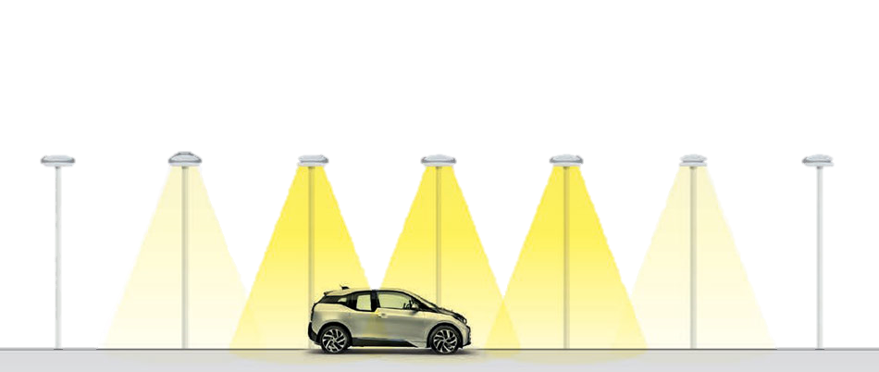
Smart Street Light

Slide 2
Team Members
Mentor
Anupesh Kumar Verma(20205039)
Anushka Chauhan(20203029)
Chowdam Charitha(20202031)
Kandukuri Yaswanth(20201057)
Ritika Singh(20203123)
Shivam Kumar Jaiswal(20203137)
Samriddhi Dhiraj(20205136)
Amit Gupta(20194090)

Slide 3
Theme of the project:
This project is about smart street light
The main objective of this project is to build street lights that only turn on , when an object movement is detected.
This would mainly help to reduce the energy consumed by the street lights , thus contributing to sustainable development.
Also this helps to decrease the effort of human labour.
Smart street lights reduces the cost of power the government has to bear worldwide.

Slide 4
TECH STACK USED:
Python
NumPy
OpenCV
YOLO

Slide 5
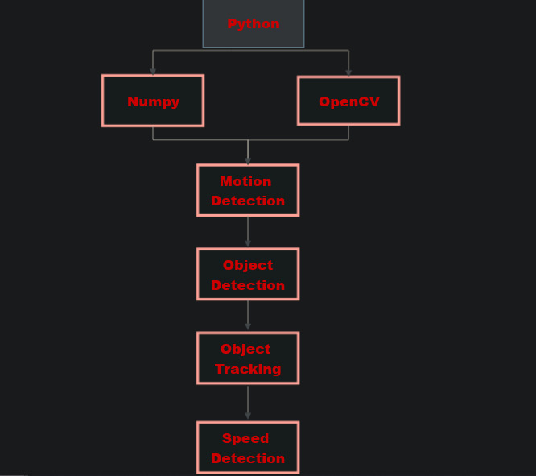
FLOW CHART:

Slide 6
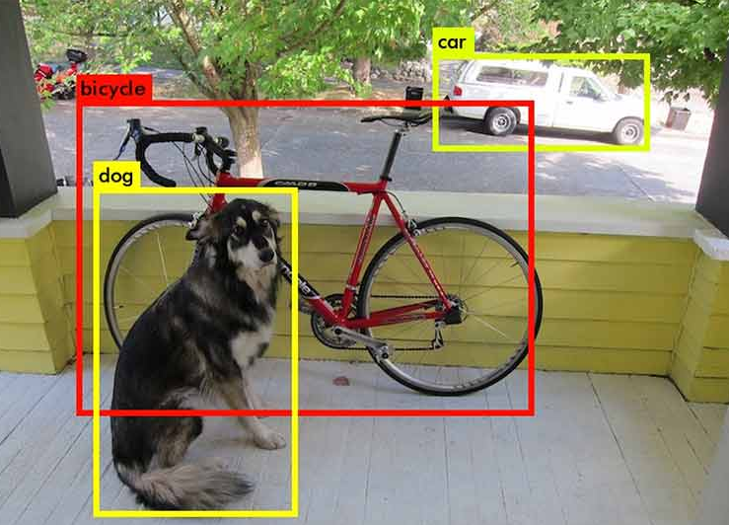
OBJECT DETECTION IN IMAGE:
Object detection is a computer vision technique that allows to identify real-world objects such as human faces, flowers, cars etc... in images or videos.
Object detection can be done under two different approaches:
1) Machine learning approach
2) Deep learning approach
In this project we are using Yolo object detection algorithm which is an algorithm that detects and recognizes various objects in a picture in real time.

Slide 7
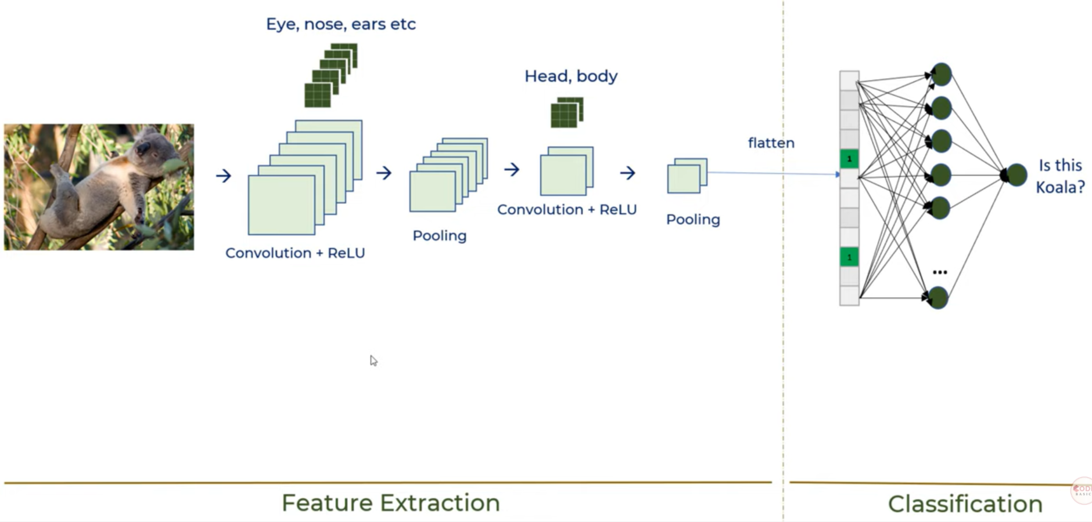
Mechanism of Yolo object detection:
Object detection process in image

Slide 8
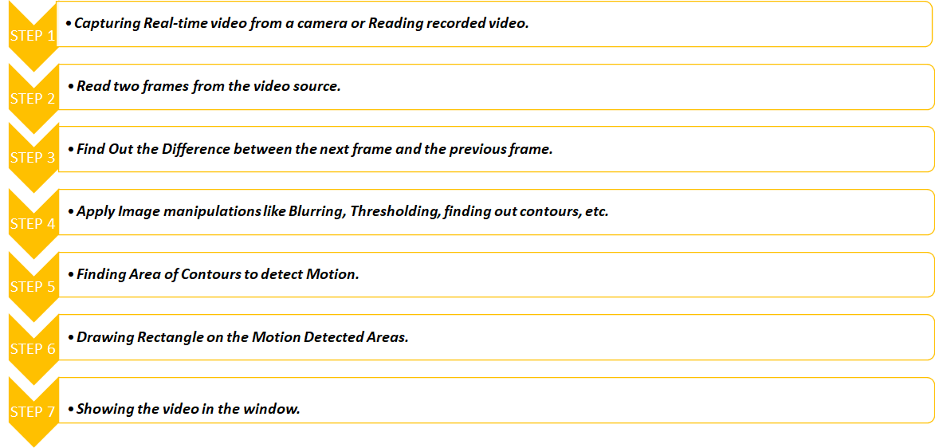
VEHICLE DETECTION AND MOTION STATUS:

Slide 9
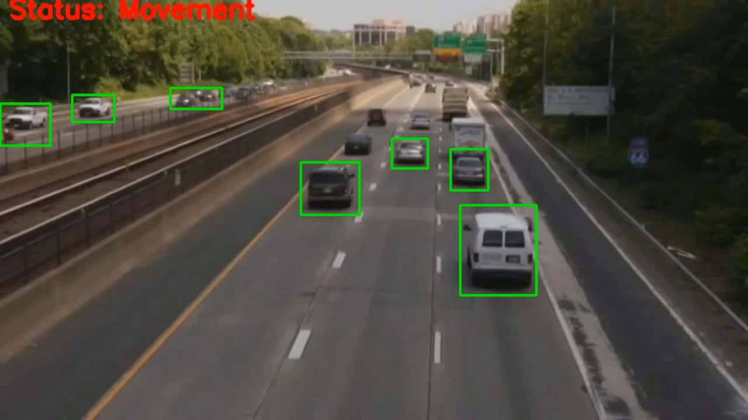
CODE RUN ON SAMPLE VIDEO:

Slide 10
OBJECT TRACKING IN VIDEO:
Step 1
We will firstly capture a video from webcam.
Step 2
Step 3
Step 4
Then centroid of the object with high intensity will be located.
Then bounding box (rectangle, circle, etc.) will be generated for the located body.
Then trajectory will be generated of the moving object which was located initially. And also ray will be traced.
Step 5
So, by this procedure path of the moving object will be traced.

Slide 11
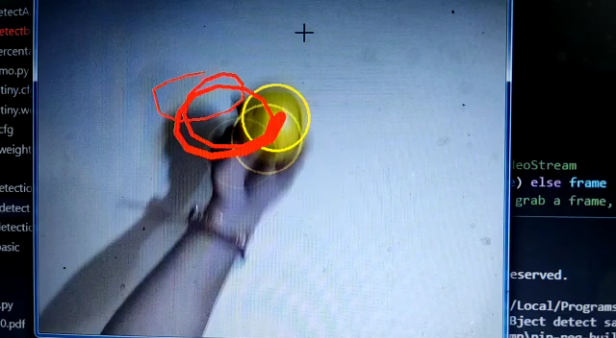
SAMPLE VIDEO OF OBJECT TRACKING:

Slide 12
SPEED ESTIMATION IN VIDEO:
Step 1
Firslty, we take video input from a webcam or any video
Step 2
We Made a function for speed estimation in km/hour.
Step 3
Then using cascade Classifier we detect vehicles and assign them a carID.
Step 4
Step 5
After converting frames to grayscale, draw a rectangle over the detected vehicle.
Using the speed estimation function, detect the speed of each vehicle and put text on each frame.
Step 6
Showing the result video and also get an output video saved in the storage.

Slide 13
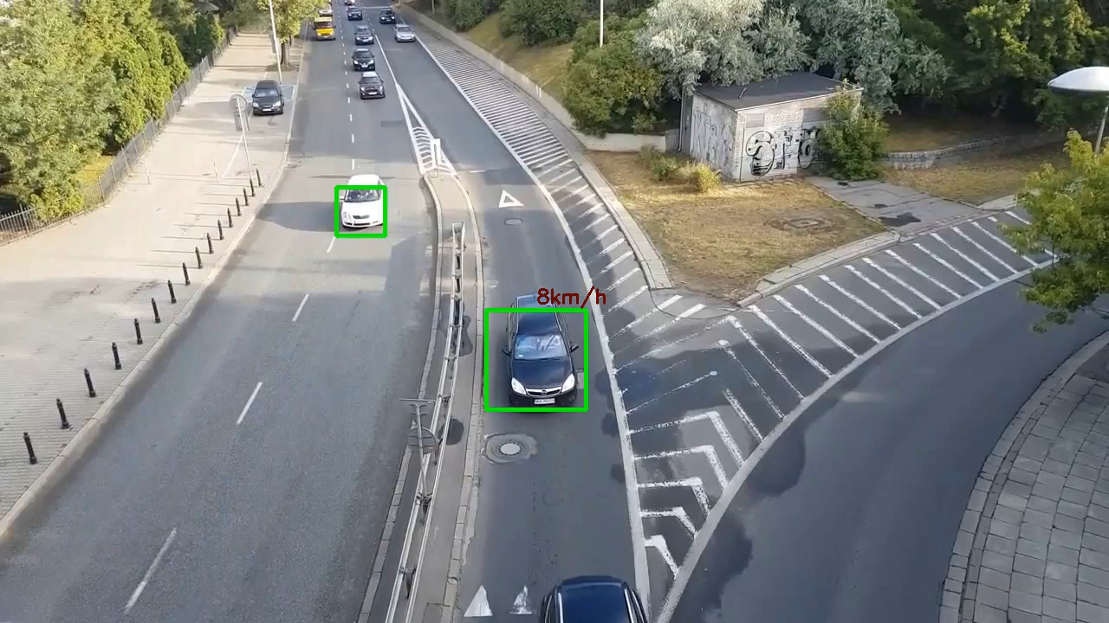
Sample Video Of Speed Estimation:

Slide 14
REFERENCES USED:
After researching and learning from different internet sources and we get two reference which can use for vehicle detection , Tracking and speed estimation.
https://www.pyimagesearch.com/2019/12/02/opencv-vehicle-detection-tracking-and-speed-estimation/
https://youtube.com/playlist?list=PLS1QulWo1RIa7D1O6skqDQ-JZ1GGHKK-K
https://youtu.be/QlMsuCL_bXs
By Learning and implementing from these resources we are able to complete these tasks.

Slide 15
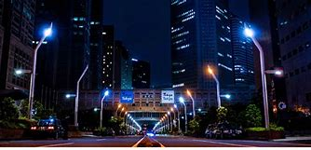
FUTURE SCOPE OF SMART STREET LIGHTS:
We can forward the stream of camera and license plate of car to some database.
Further we will add license plate number detection using which we can give online challan to drivers who exceed the speed limit in that region.
Parking management, such as alerting officials of illegally parked vehicles or drivers of open spaces.

Slide 16
ADVANTAGES OF SMART STREET LIGHTS....
Enhance public safety via networked surveillance and environmental monitoring.
Consume far less energy than traditional incandescent bulbs.
Smart streetlights can support digital signage, environmental condition monitoring as well as traffic monitoring.
Reduction in CO₂ emission and hence reduction in light pollution.
Used for broadcasting public address announcements in case of emergencies .
More energy-efficient LED bulbs, as well as wireless connectivity, motion sensors that activate lights when passersby are near

Slide 17


